Slide 1
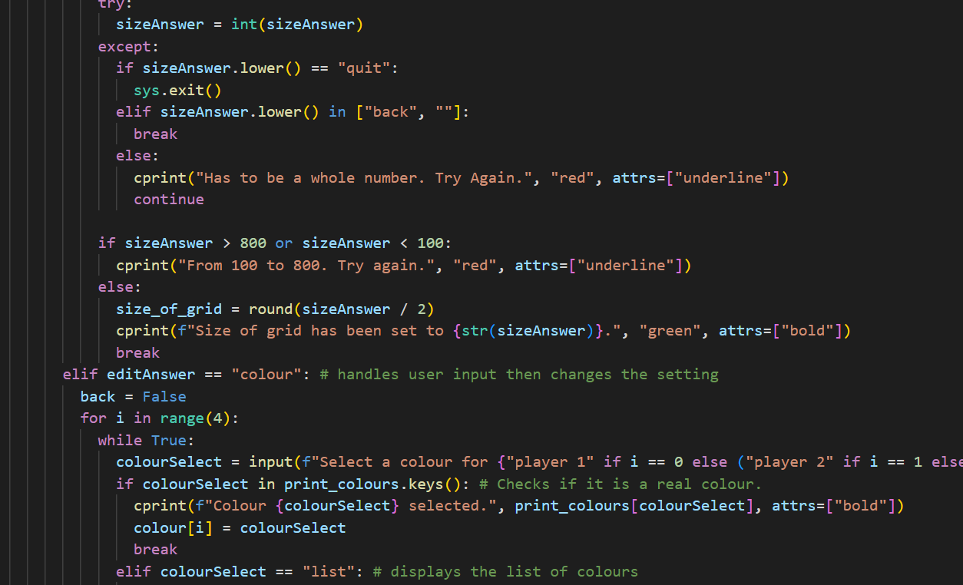
My Code
CAT Year 8, Investigation 1

Slide 2
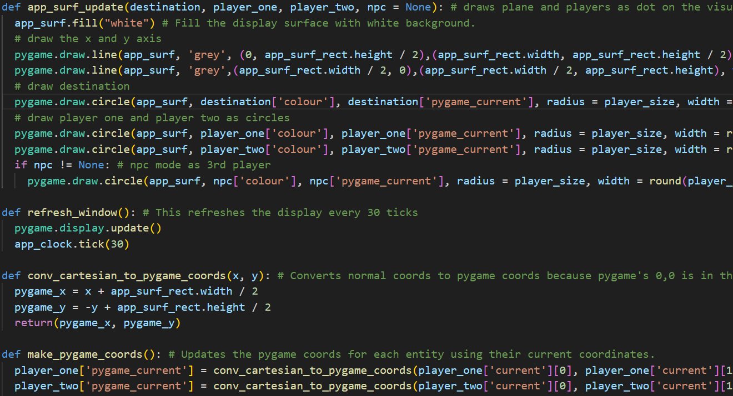
Part 1
My Movement & Functions
1.1 Create and explain a reusable means of achieving translations (10 Marks)
1.2 Use functions, validate input and document imports (10 Marks)

Slide 3
1.1 Create and explain a reusable means of achieving translations (10 Marks)
The Thinking Process🤔
Let’s say the player wanted to move for the distance 5 in direction 1.
3
2
1
4
1
5
8
6
7

Slide 4
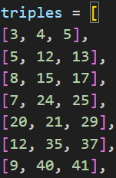



So, we can use the a and b values to move along the hypothenuse.
The distance is 5, and we need to move along the hypothenuse of a triple.
Since we are moving along the hypothenuse, the distance is practically the hypothenuse.
3
2
1
4
1
5
8
6
7

Slide 5









This will end up moving us along the hypothenuse.
To move in direction one, we will need to move across by B and up by A.
3
2
The distance is 5, and we need to move along the hypothenuse of a triple.
Since we are moving along the hypothenuse, the distance is practically the hypothenuse.
1
4
1
5
8
6
7

Slide 6
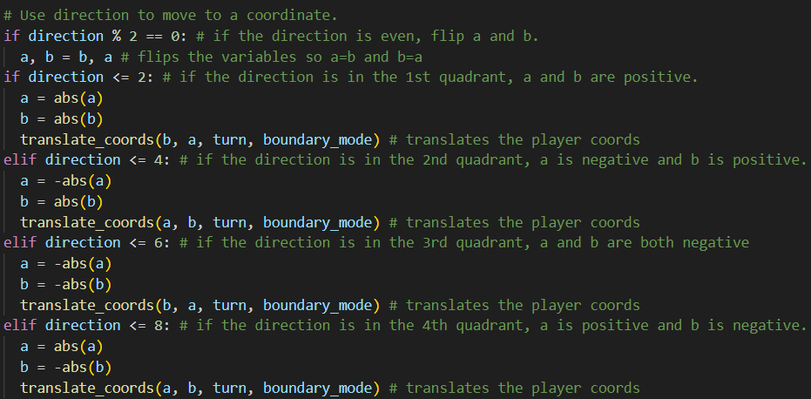
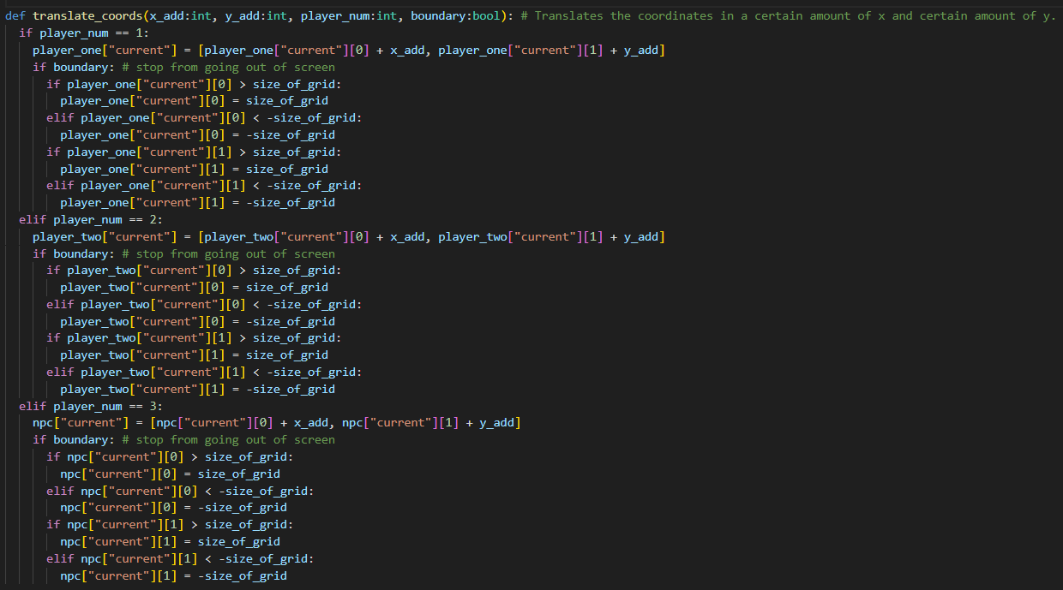
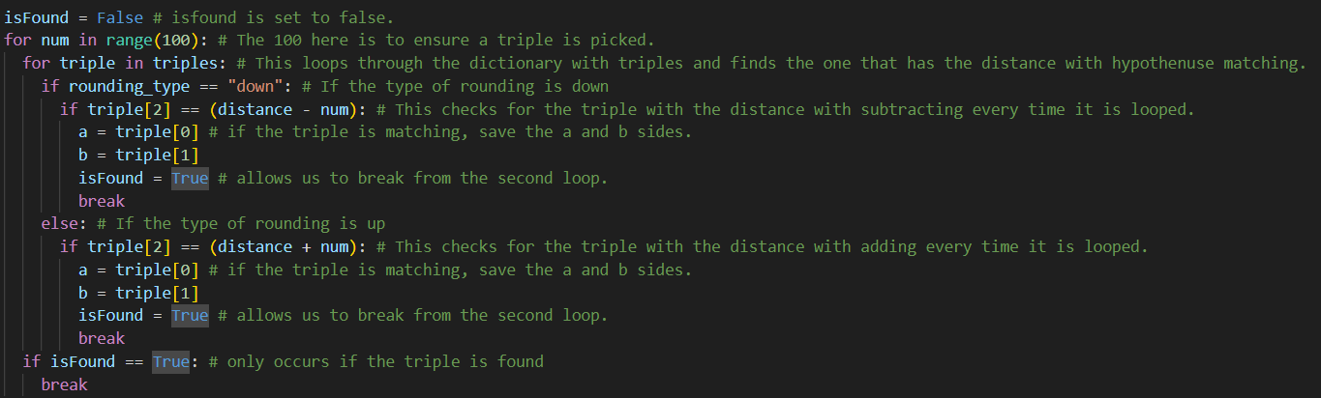
1.1 Create and explain a reusable means of achieving translations (10 Marks)
The Application Process

Slide 7
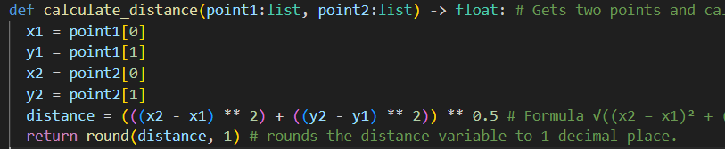
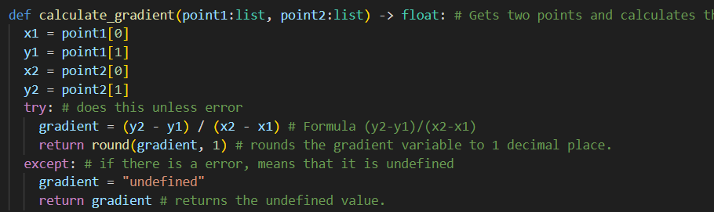
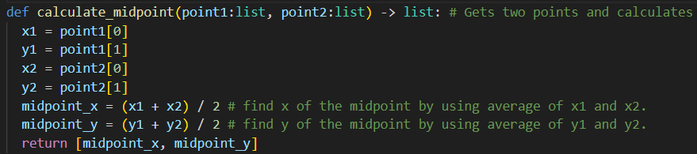
1.2.1 Use functions (5 Marks)

Slide 8
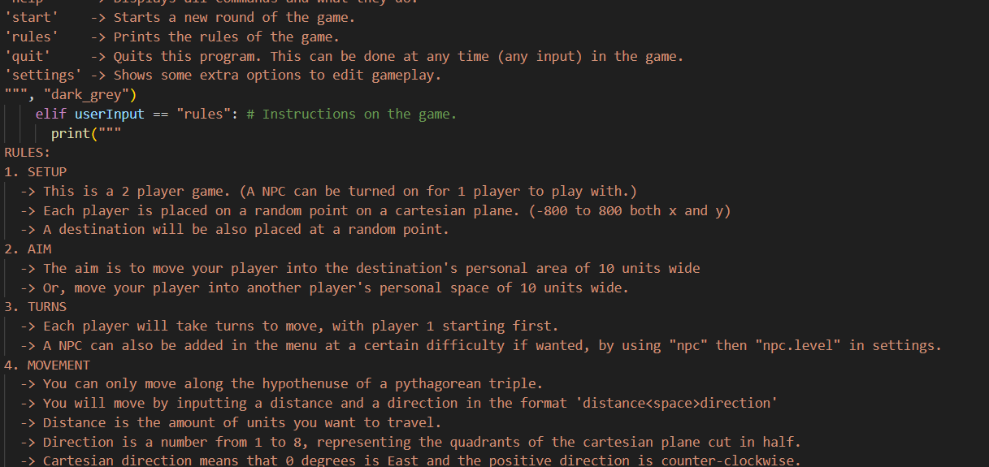
1.2.2 Document Imports

Slide 9
1.2.3 Validate Input (5 Marks)

